Slide 1
03
Session 3 of 24
Summarising and showing data honestly
How do we describe thousands of rows in one sentence and one chart without misleading anyone?
Jotham Martin Wambi, KLAi Professional Learning
Session 3 Summarising and showing data honestly
1
Notes:
Session 3 starts where Session 2 stopped. You know what one row means and how the tables link. Today we describe thousands of rows in one sentence and one chart, and we do it with no code, in Google Sheets. By the end you'll have a pivot table and two charts that don't mislead built from Lakeside Mart sales. You'll also meet a finding that surprises almost everyone. The average order is more than double the typical order.

Slide 2
By the end of today
How the two hours run
Choose mean or median and say why.
Recall and warm-up
10 min
Read a histogram, a box plot and a line chart.
Concepts and explanation
30 min
Live demonstration
25 min
Spot a misleading axis.
Break
5 min
Guided lab
40 min
Check and wrap-up
10 min
Session 3 Summarising and showing data honestly
2
Notes:
By the end of today you'll choose between the mean and the median and say why. You'll read a histogram, a box plot and a line chart, and you'll spot a misleading axis. Most of the teaching happens inside the workbook. I build the pivot table live in Sheets, and the lab asks you to build it again on your own copy, so keep the workbook open in your browser from the start.

Slide 3
Vocabulary
Word | Plain meaning | In a spreadsheet
Median | The middle value when numbers are sorted. Half sit below it and half above. | =MEDIAN(range)
Quartile | One of three cut points that split sorted numbers into four equal groups. | =QUARTILE(range, 1)
Standard deviation | A typical distance of the values from the mean. Bigger means more spread out. | =STDEV(range)
Skew | A lopsided shape with a long tail on one side. | No equivalent. A new idea.
Histogram | A chart that counts how many values fall in each band of equal width. | Chart type: Histogram chart
Pivot table | A table that groups the rows and summarises each group. | Insert, Pivot table
Truncated axis | A chart axis that starts above zero, which makes differences look bigger. | No equivalent. A new idea.
Session 3 Summarising and showing data honestly
3
Notes:
Seven words today, and most of them live in the spreadsheet you already know. The median is the middle value, and Sheets gives it to you with one formula. A quartile is a cut point that splits sorted numbers into four groups. Standard deviation measures spread. Skew is a lopsided shape. A histogram counts values in bands. A pivot table groups rows and summarises each group. A truncated axis is a chart base that starts above zero. The right hand column shows the Sheets version of each.

Slide 4
Warm-up from Session 2
1
What does one row of the orders table stand for?
One till order. That is the grain of the table.
2
How does an order know which branch it belongs to?
Its branch_id matches the key in the branches table.
Session 3 Summarising and showing data honestly
4
Notes:
Let's recall grain and keys first, because every number today depends on them.
First. What does one row of the orders table stand for? Think back to the grain. Have a think.
One row is one till order. That's the grain of the table, and it matters today, because every total and every average we make counts or adds those orders.
Second. How does an order know which branch it belongs to? No rush.
Each order carries a branch_id, and that same code is the key in the branches table. Today you'll group orders by that code, and the pivot table will do the linking work for you.

Slide 5
Six summary jobs, each one formula in Sheets
Job | Formula | Workbook answer
Count the orders | =COUNT(G2:G2001) | 2,000
Total revenue | =SUM(G2:G2001) | 99,861,360
Mean | =AVERAGE(G2:G2001) | 49,931
Median | =MEDIAN(G2:G2001) | 24,800
Smallest order | =MIN(G2:G2001) | 1,140
Largest order | =MAX(G2:G2001) | 1,935,520
Column G holds order_value_ugx. All amounts are in UGX.
Session 3 Summarising and showing data honestly
5
Notes:
Open the Lakeside Mart workbook in Google Sheets. Column G holds the value of each order, from row two down to row two thousand and one.
You already know most of these formulas. Count tells you how many orders there are, two thousand. Sum adds them up, ninety nine million eight hundred and sixty one thousand three hundred and sixty shillings. Mean is the average you've used all your working life. Add everything up and divide by how many there are.
Median is the new word. Sort the orders from smallest to largest and take the one in the middle. In this workbook that's twenty four thousand eight hundred shillings. The mean is about twice as big as the median. That gap is today's main story, and we'll spend some time on why it happens.

Slide 6
The workbook is a slice of the full file
Workbook, 2,000 orders
Full file, 30,229 orders
Mean 49,931 UGX
Mean 47,491 UGX
Median 24,800 UGX
Median 23,200 UGX
Mean is 2.01 times the median
Mean is 2.05 times the median
A sample gives close numbers that are never identical. The story is the same.
Session 3 Summarising and showing data honestly
6
Notes:
The workbook you'll use has only two thousand orders. It's a sample, a slice, drawn from the full Lakeside Mart file of thirty thousand two hundred and twenty nine orders.
On the left are the workbook numbers. The mean is forty nine thousand nine hundred and thirty one shillings, and the median is twenty four thousand eight hundred.
On the right are the numbers from the full file. The mean is forty seven thousand four hundred and ninety one, and the median is twenty three thousand two hundred.
So your answers in Sheets will be close to the full file, and they will never match it exactly. In both, the mean is more than double the median. The finding is the same either way. Session 4 is all about why a sample differs from the whole.

Slide 7
Median
The middle value when the numbers are sorted. Half the values sit below it and half above.
In our data
In a spreadsheet
Sort the 2,000 order values in the workbook. The middle sits at 24,800 UGX.
=MEDIAN(G2:G2001), or sort the column and look at the middle row.
Session 3 Summarising and showing data honestly
7
Notes:
One word to hold on to. The median.
In plain words, sort the numbers from smallest to largest and take the one in the middle. Half the values sit below it and half sit above it.
In our workbook, the middle order is worth twenty four thousand eight hundred shillings. So half of all orders are smaller than that.
That makes the median useful. Take away the biggest order in the workbook, over one and a half million shillings, and the median doesn't move at all. The mean drops by about nine hundred and forty three shillings. The median ignores how large the large values are. It only cares about their position in the line.

Slide 8
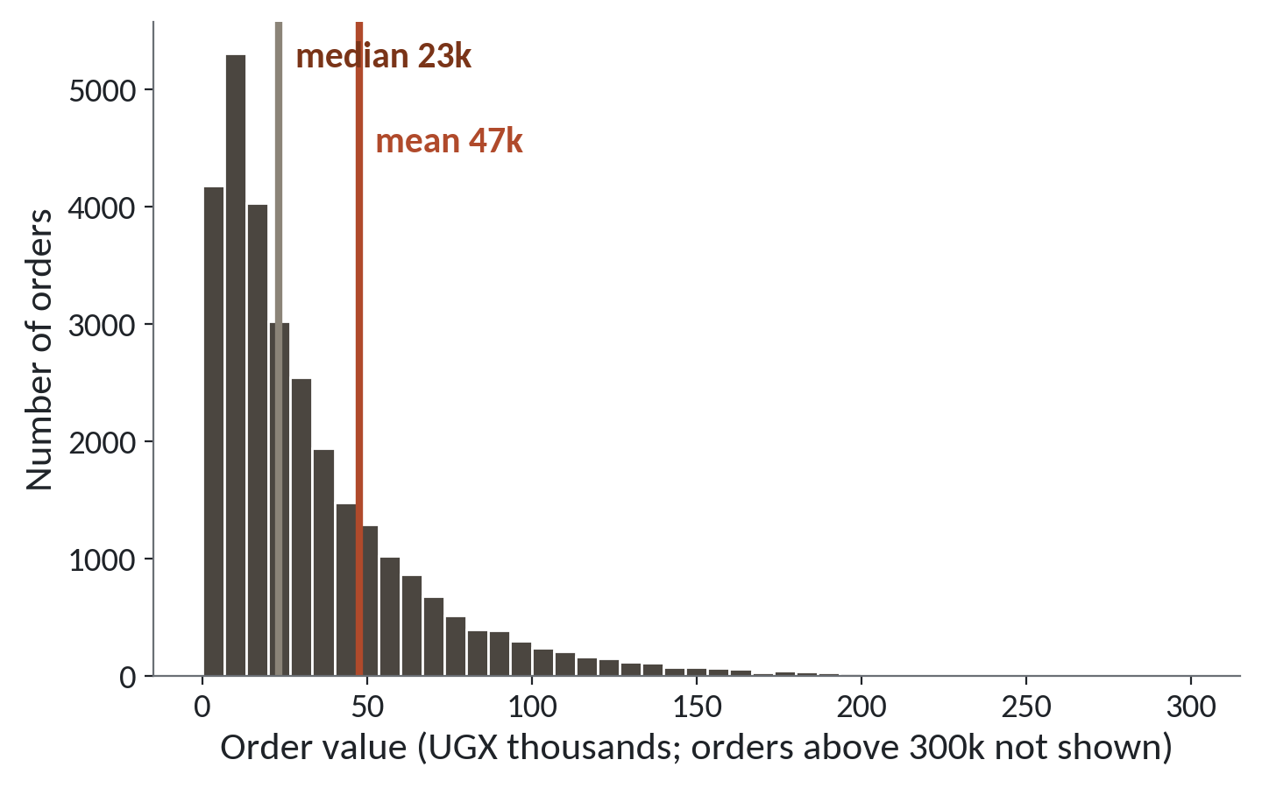
A few very large orders pull the mean up
1
Most orders are small. The tallest bars sit on the left.
2
A long tail of large orders runs to the right.
3
The mean sits far to the right of the median.
Full file. Median 23,200 UGX. Mean 47,491 UGX.
Session 3 Summarising and showing data honestly
8
Notes:
This is a histogram. It's a chart that counts how many orders fall into each band of equal width. Each bar is one band of order value, and the bar's height is the number of orders in it. This one uses all thirty thousand orders in the full file.
Start with the left side. Most orders are small, and the tallest bars sit there.
Then follow the bars to the right. They get shorter and shorter, and a long thin tail of large orders runs out towards three hundred thousand.
Now the two lines. The gold line is the median, twenty three thousand two hundred shillings. The red line is the mean, forty seven thousand four hundred and ninety one. The few large orders drag the mean to the right.
So here's a question. A manager asks what a typical order is worth. Which line would you give? Mull it over.
The gold one. The median. Hardly any orders look like the mean.

Slide 9
Reporting the mean as the typical order
What it looks like
Why it goes wrong
The fix
You write: a typical Lakeside order is worth 49,931 UGX. The formula is correct and the sentence sounds sensible.
Half the orders are under 24,800 and about three in four are under 50,000. A few huge orders pull the mean up, so few orders look like it.
Give the median beside the mean and say how many orders you counted. For money amounts, lead with the median.
Session 3 Summarising and showing data honestly
9
Notes:
Today's trap is one that Sheets will not warn you about.
You calculate the average order, forty nine thousand nine hundred and thirty one shillings, and write that a typical order is worth about fifty thousand. The formula is right. The sentence sounds sensible. A manager would nod.
But it's wrong as a description of a typical order. Half of all orders are worth less than twenty four thousand eight hundred, and about three in four are worth less than fifty thousand. The mean is the balance point, and a handful of very large orders drag that balance point upwards.
So put the median next to the mean, and say how many orders you counted. When the two numbers are far apart, lead with the median and tell the reader why.

Slide 10
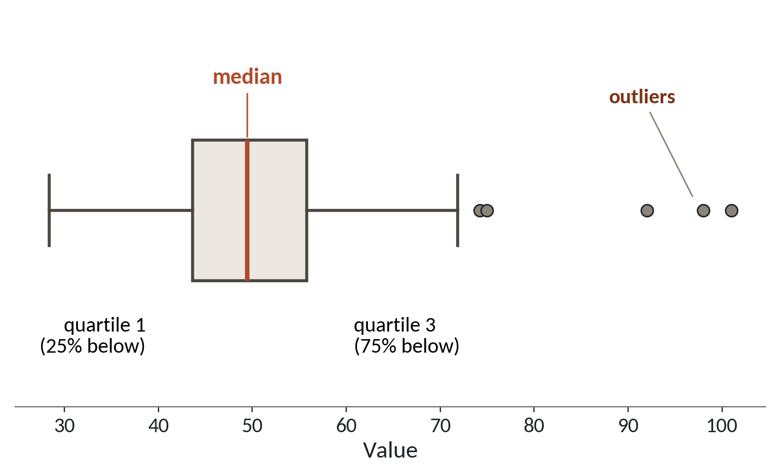
Reading a box plot
1
The box holds the middle half of the values.
2
The line inside the box is the median.
3
Dots far beyond the whiskers are outliers.
A drawing with made-up numbers, to learn the parts.
Session 3 Summarising and showing data honestly
10
Notes:
Now the spread. The median tells us the middle. The spread tells us how widely the values are scattered around it. A box plot shows both in one small picture. This one is a drawing with made up numbers, so we can learn its parts.
The box holds the middle half of the values. Its left edge is the first quartile, with a quarter of the values below it. Its right edge is the third quartile, with three quarters below it. A quartile is one of the three cut points that split sorted numbers into four equal groups.
The line inside the box is the median, the middle cut point.
The whiskers reach out to the ordinary values. A common rule stops each whisker one and a half box lengths beyond the box. The dots beyond them are outliers. An outlier is a value far away from the rest. In the workbook, Sheets gives a first quartile of about ten thousand four hundred and a third quartile of about forty nine thousand four hundred. So the middle half of our orders fall between those two amounts.

Slide 11
Standard deviation
A typical distance of the values from the mean. A bigger number means the values are more spread out.
In our data
In a spreadsheet
In the workbook it is 128,094 UGX. That is bigger than the mean of 49,931, a warning that a few huge orders stretch the data.
=STDEV(G2:G2001)
Session 3 Summarising and showing data honestly
11
Notes:
The second way to measure spread is the standard deviation.
In plain words, it's a typical distance of the values from the mean. If every order were close to the mean, it would be small. If orders were scattered far from the mean, it would be large.
In our workbook it's one hundred and twenty eight thousand and ninety four shillings. Compare that number with the mean of forty nine thousand nine hundred and thirty one. The spread is more than twice the average itself. That tells you a few huge orders are stretching the data, and the simple picture of an average order with a small wobble around it doesn't fit.
In Sheets it's one formula, STDEV, applied to the same column.

Slide 12
Standard deviation and the middle half can disagree
Branch | Middle half, Q1 to Q3 | Standard deviation | Biggest order
Jinja (B04) | 9,598 to 54,510 | 215,195 | 1,935,520
Mbale (B05) | 8,575 to 49,185 | 68,569 | 441,600
Workbook, UGX. Huge orders inflate the standard deviation. The middle half barely moves.
Session 3 Summarising and showing data honestly
12
Notes:
Let's compare two branches in the workbook, Jinja and Mbale.
Start with the middle half. In Jinja it runs from about nine thousand six hundred to fifty four thousand five hundred shillings. In Mbale it runs from about eight thousand six hundred to forty nine thousand two hundred. Those are close. On an ordinary day the two branches look alike.
Now the standard deviation. Jinja is two hundred and fifteen thousand, and Mbale is sixty eight thousand. Jinja looks three times more spread out.
The reason is in the last column. Jinja holds the biggest order in the workbook, over one and a half million shillings, and Mbale's biggest is only about four hundred and forty thousand. One measure says the branches are alike, and the other says they're very different. When data has a long tail, the quartiles are the safer guide.

Slide 13
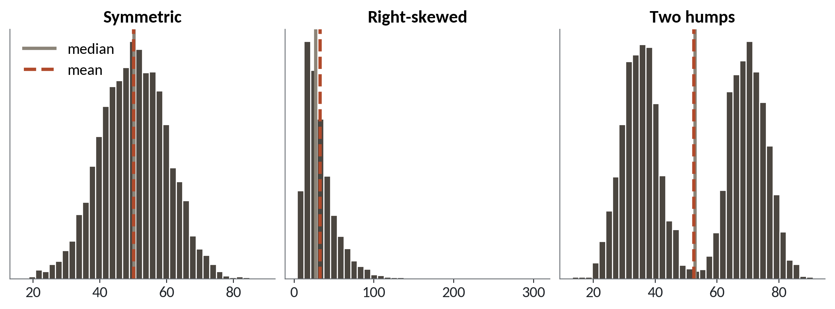
Three shapes of data
1
Symmetric: the mean and median sit together.
2
Right-skewed: a long right tail pulls the mean past the median.
3
Two humps: the mean and median fall in the gap between them.
Shapes drawn from simulated data. Lakeside order values look like the middle one.
Session 3 Summarising and showing data honestly
13
Notes:
The shape of the histogram tells you which summary to trust. These three are drawn from simulated data, to show the patterns.
On the left is the symmetric shape. The two sides mirror each other. The mean and the median sit on top of each other, so either one is fine.
In the middle is a right-skewed shape. Skew means a lopsided shape with a long tail on one side. Here the tail runs to the right, and it pulls the mean past the median. Money amounts usually look like this, and Lakeside orders do too.
On the right are two humps. Both lines land in the empty gap between the humps, where almost no values live. Two humps usually mean two groups mixed together, so the fix is to split the data into its groups and summarise each one on its own.

Slide 14
A pivot table is a GROUP BY
Pivot table in Sheets
Database phrase
Rows: branch_id
GROUP BY branch_id
Values: SUM of order_value_ugx
SUM(order_value_ugx)
One answer row per branch
One answer row per branch
Same idea. Split the rows into groups, then summarise each group.
Session 3 Summarising and showing data honestly
14
Notes:
Now the tool that does most of the work in everyday analysis. A pivot table is a table that groups your rows and summarises each group. You may have used one already.
On the left is what you do in Sheets. You drop branch_id into Rows, and you drop order_value_ugx into Values, set to add up. You get one row of answer for each branch.
On the right is the same job in the language that databases speak. The phrase GROUP BY says split the rows by branch, and the SUM says add up each group. Again, one answer row per branch.
We write that language ourselves in Session 10, so don't worry about it today. I'm showing it so that the word GROUP BY is already familiar when it comes. A pivot table and a GROUP BY are the same idea.

Slide 15
One pivot table, three summaries by payment method
Payment method | Orders | Mean | Median
Card | 143 | 71,130 | 26,440
Cash | 881 | 50,125 | 26,400
Mobile money | 976 | 46,649 | 23,800
Workbook pivot table, UGX. Summarise by COUNT, AVERAGE and MEDIAN.
Session 3 Summarising and showing data honestly
15
Notes:
This pivot table comes from the workbook. Rows are payment methods. The values are the order count, the average and the median of the order value.
By the mean, card orders look much richer. They average seventy one thousand shillings, and mobile money orders average forty six thousand six hundred and forty nine. That's a gap of about twenty four thousand five hundred.
Now read the median column. Card is twenty six thousand four hundred and forty, and mobile money is twenty three thousand eight hundred. The gap shrinks to about two thousand six hundred.
So most of the card advantage comes from a few huge card orders. There are only one hundred and forty three card orders in this workbook, so a few big ones go a long way. Always check the count and the median before you say that one group spends more.

Slide 16
Build the branch by month pivot table
Month column
Insert
Rows
Columns
Values
Insert, Pivot table, new sheet
Add branch_id
Add month
Add order_value_ugx, SUM
In H2 type =LEFT(B2,7), fill down
Check: the grand total is 99,861,360 UGX.
Session 3 Summarising and showing data honestly
16
Notes:
Let's build the pivot table together, step by step.
First we need a month column. The dates in this workbook are stored as text, like 2024 dash 01 dash 07. The formula LEFT takes the first seven characters, which gives the year and the month. Type it in the first empty column, header month, and fill it down.
Second, select all your data and choose Insert, then Pivot table, and put it in a new sheet.
Third, add branch_id to Rows. Each branch gets a row.
Fourth, add month to Columns. Each month gets a column.
Fifth, add order_value_ugx to Values and make sure it says SUM. Sheets sometimes picks count, so check.
Then run the safety check. The grand total in the corner must be ninety nine million eight hundred and sixty one thousand three hundred and sixty shillings. If it isn't, something is missing.

Slide 17
Revenue by branch and month, first three months
Branch | Jan 2024 | Feb 2024 | Mar 2024
B01 Kampala Central | 538,140 | 2,016,190 | 346,550
B02 Kampala Ntinda | 591,670 | 431,565 | 708,590
B03 Entebbe | 243,935 | 280,440 | 329,465
B04 Jinja | 474,465 | 514,675 | 2,340,250
B05 Mbale | 302,860 | 357,055 | 230,915
B06 Mbarara | 393,195 | 641,185 | 238,520
B07 Fort Portal | 110,530 | 327,645 | 202,000
B08 Gulu | 731,310 | 162,730 | 385,655
Workbook, UGX. Jinja in March holds the single 1,935,520 UGX order.
Session 3 Summarising and showing data honestly
17
Notes:
This is the top left corner of your pivot table. Eight branches down, the first three months across, in shillings.
Check yours against this. Kampala Central in January is five hundred and thirty eight thousand one hundred and forty. Fort Portal in January is one hundred and ten thousand five hundred and thirty.
Now look at the highlighted row. Jinja in March is two million three hundred and forty thousand two hundred and fifty. That's far above every other cell. It happens because the biggest order in the workbook, one million nine hundred and thirty five thousand five hundred and twenty shillings, was rung up in Jinja on the twenty eighth of March.
One order can make a whole cell look special. A pivot table of sums is sensitive to big orders, just as the mean is. Keep that in mind when you read the lab results.

Slide 18
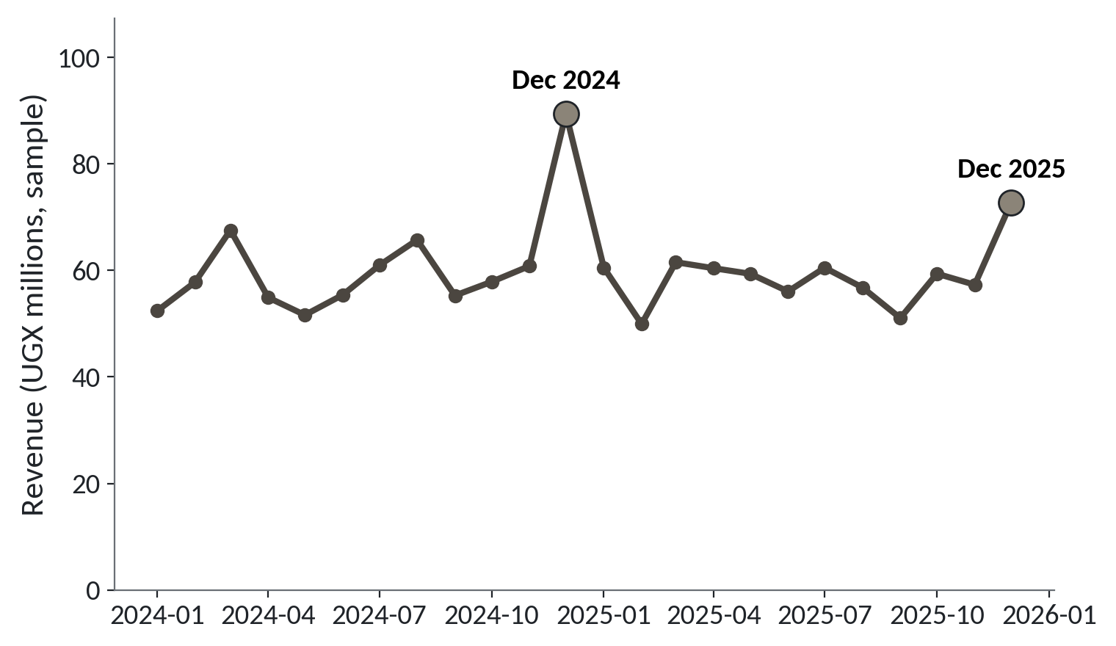
A line chart shows change over time
1
Revenue jumps every December, to about 89.5 million in 2024.
2
Other months stay between about 50 and 68 million.
3
Time runs left to right, so a line is the right chart.
Full file, UGX millions. December 2025 reached 72.8 million.
Session 3 Summarising and showing data honestly
18
Notes:
When the question is about change over time, draw a line. Time runs from left to right, and the line joins one month to the next. It's the full file, so the figures are in millions of shillings.
The first thing you see is December. In December 2024 revenue reached about eighty nine and a half million. December 2025 reached about seventy three million.
Now look at the other months. They stay in a band from about fifty to sixty eight million. So the December peak is real and large.
The axis starts at zero, so the heights can be compared fairly. Now a warning. In your workbook of two thousand orders, December 2024 comes only third among the months, even though it has the most orders, one hundred and sixteen. With about eighty orders a month, a few big baskets can reorder the months. That is the sample at work, and we meet it properly in Session 4.

Slide 19
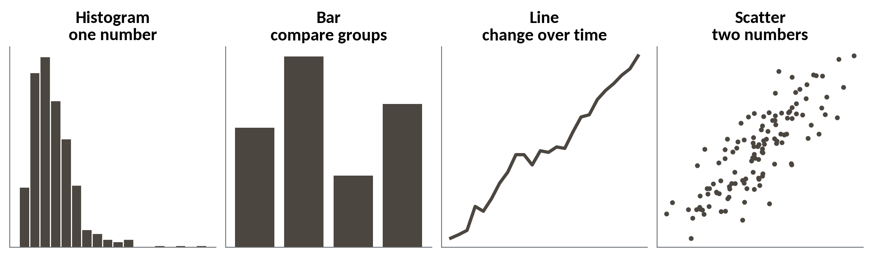
Choosing a chart from the question
1
One number across many rows: a histogram.
2
Groups side by side: a bar chart. Change over time: a line.
3
Two numbers together: a scatter plot.
Ask what the question is first. Then pick the chart.
Session 3 Summarising and showing data honestly
19
Notes:
Choosing a chart is easy once you know your question. Four charts cover most of what you'll need.
A histogram answers how a single number is spread out. We used it for order value.
A bar chart compares groups, such as branches or payment methods. A line chart shows change over time, like revenue by month.
A scatter plot puts two numbers on one picture, one on each axis, so you can see whether they move together. We'll use scatter plots in Session 4. So before you open the chart menu, say your question in one sentence. The sentence tells you the chart.

Slide 20
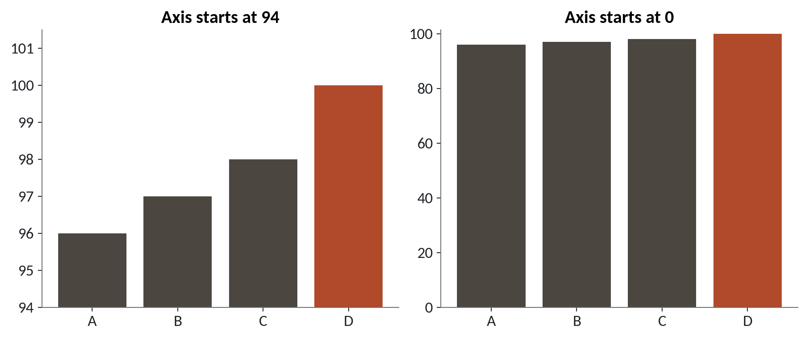
The same four numbers on two axes
1
Left: the axis starts at 94, so D looks three times as tall as A.
2
Right: the axis starts at zero and the bars look almost equal.
3
Both charts use the same four numbers.
Made-up values 96, 97, 98 and 100. A bar's length shows its size, so bars start at zero.
Session 3 Summarising and showing data honestly
20
Notes:
Last idea for the lecture part. A chart can be accurate in every number and still mislead you, because of the axis. These are made up values, so no real branch is being accused.
On the left, the vertical axis starts at ninety four. Bar D, at one hundred, looks three times as tall as bar A, at ninety six. That's because we only see the part above ninety four.
On the right, the axis starts at zero. Now the four bars are almost the same height, which is the truth. The values are ninety six, ninety seven, ninety eight and one hundred.
Bars show size by their length, so the base of a bar chart should be zero. Sheets will sometimes choose a cut axis for you. You'll meet that in the lab, so check the axis every time you make a chart.

Slide 21
Lab: pivot, histogram and a chart to fix
1
Open lakeside_for_sheets.xlsx in Google Sheets
Tool and time
Google Sheets
40 minutes
2
Add a month column and build the branch by month pivot
3
Find the mean, median, quartiles, spread and whisker limit
You are done when
4
Draw a histogram of order value
Your pivot grand total is 99,861,360 and every bar chart starts at zero.
5
Chart the median by branch and fix its axis
6
Chart revenue by month as a line
7
Write one sentence on mean versus median
Session 3 Summarising and showing data honestly
21
Notes:
The first task is a month column. Open the workbook, add the column, and build the branch by month pivot table we just made together. Forty minutes in Google Sheets.
After that you'll find your summary numbers with formulas, including the limit where a box plot's whisker stops, and draw a histogram of order value. Then you'll make a branch chart with a cut axis on purpose and fix it. The last chart is a line of revenue by month.
Every task has an answer to check against. Your numbers will be close to the full file figures we saw, and they'll differ a little, because this workbook is a sample. That's expected.
You're done when your grand total reads ninety nine million eight hundred and sixty one thousand three hundred and sixty, and your bar charts start at zero. I'll be around. If something looks odd, ask me.

Slide 22
Questions to finish
1
The mean order is 49,931 and the median is 24,800. Which do you give as the typical order, and why?
The median. A few huge orders pull the mean up, and half of all orders are below 24,800.
2
What does a pivot table do, in one sentence?
It splits the rows into groups and summarises each group, as GROUP BY does in a database.
3
A bar chart's axis starts at 94. What is wrong with it?
A bar's length shows its size, so cutting the axis exaggerates small gaps. Start at zero.
Session 3 Summarising and showing data honestly
22
Notes:
Let's put the mean and the median to work. The mean order is forty nine thousand nine hundred and thirty one and the median is twenty four thousand eight hundred. Which do you give as the typical order, and why? Sit with it for a second.
The median. A few huge orders pull the mean upwards, and half of all orders are below twenty four thousand eight hundred.
Now the pivot table. What does it do, in one sentence? Picture it for a second.
It splits the rows into groups and summarises each group. In a database that's called GROUP BY.
Last, a bar chart's axis starts at ninety four. What is wrong with it? Give that a moment.
A bar's length shows its size. If you cut the axis, small gaps look huge. Start the bars at zero.

Slide 23
Summary
Mean and median answer different questions. When a few huge values exist, lead with the median.
Describe spread with quartiles as well as standard deviation, and read the shape first.
A pivot table is a GROUP BY. Choose the chart from the question, and start bars at zero.
Next session. Uncertainty, samples and cause
Session 3 Summarising and showing data honestly
23
Notes:
One. The mean and the median answer different questions. When a few huge values pull the mean up, lead with the median and show both.
Two. Describe the spread with quartiles as well as the standard deviation, and look at the shape of the histogram before you trust any single number.
Three. A pivot table is a GROUP BY, and the chart follows from your question. Bars start at zero.
Next session, Uncertainty, samples and cause. You've seen your workbook give slightly different answers from the full file. Next time we find out exactly why, and how sure we can be about any number from a sample.

